Slide 1
Studio 1 Group Project
Jason – Palin – Donny - Cameron

Slide 2
BUG FIXING
ATTEMPTED
By Palin Wiseman

Slide 3
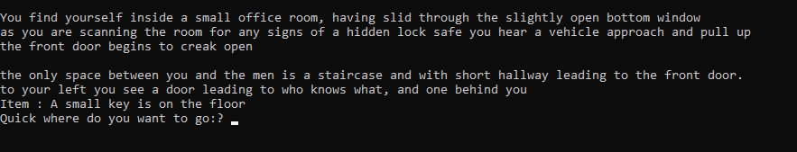
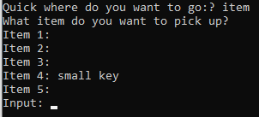
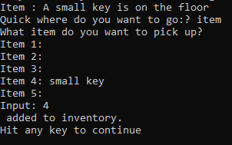
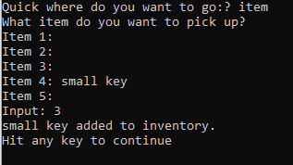
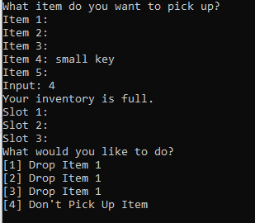
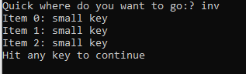
Inventory system issues

Slide 4

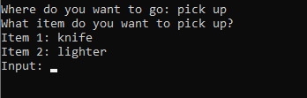
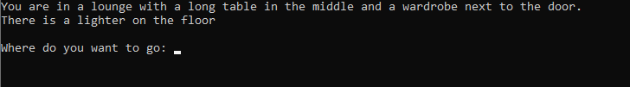
Inventory system issues Part 2

Slide 5
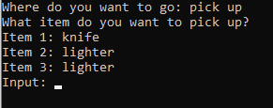

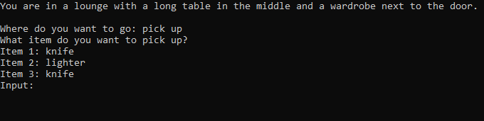
Inventory system issues Part 2

Slide 6
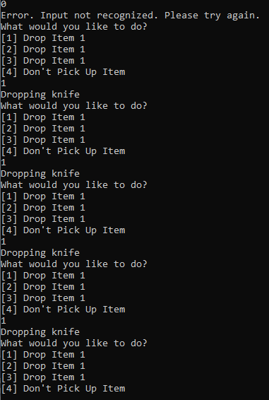
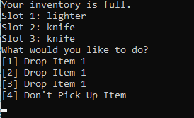
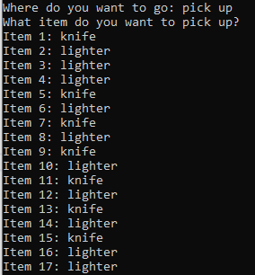
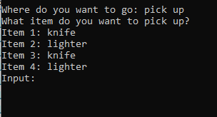
Inventory system issues Part 2

Slide 7
Bug fixing
In conclusion:
It’s important.
They’ll be back.

Slide 8
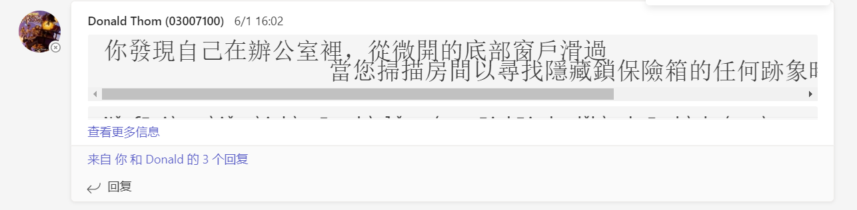
Challenge for me
First, the language problem.
Second, there are cultural differences.

Slide 9
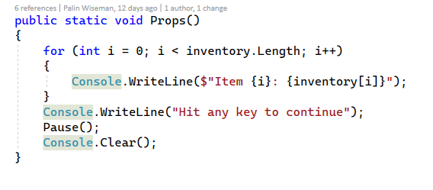
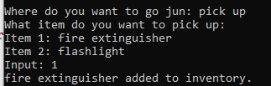
props
Put the items picked up by players in the room into the inventory through this item bar.

Slide 10
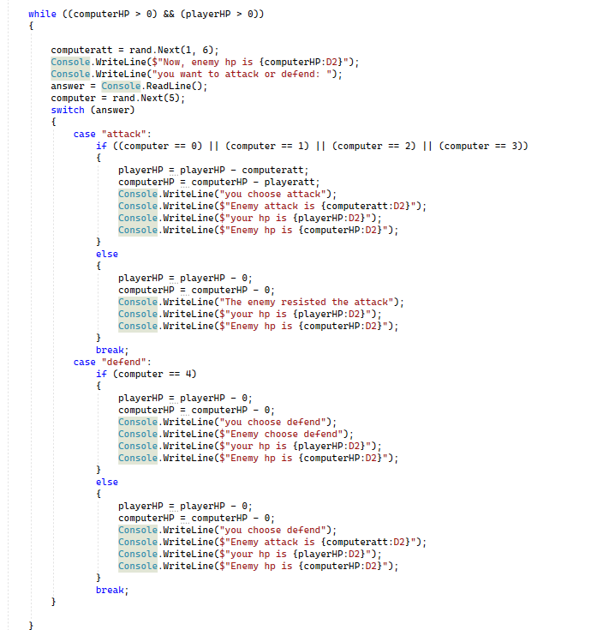
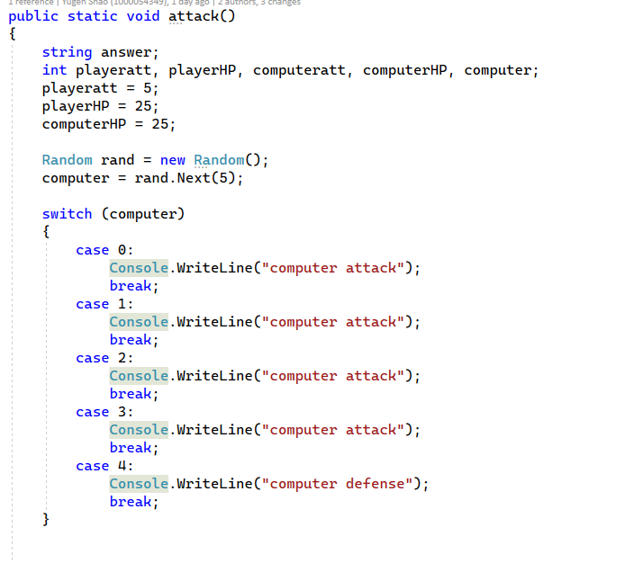
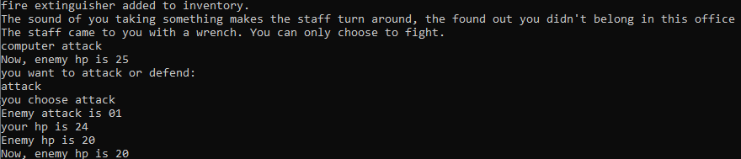
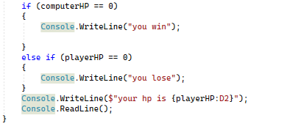
attack system
This system is used when the player encounters enemies in some rooms, in which the damage caused by enemy attacks is random. Players can choose to attack or defend during combat, as do enemies.

Slide 11
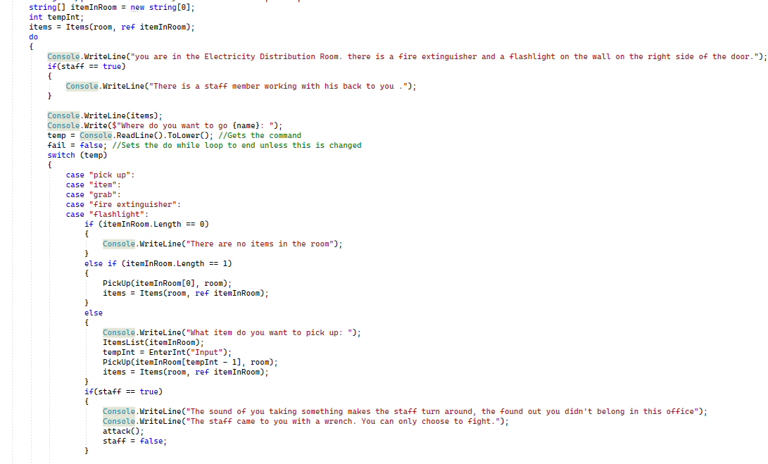
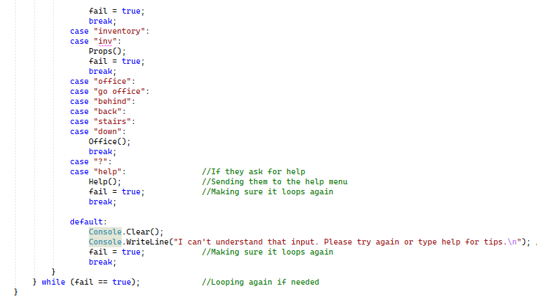
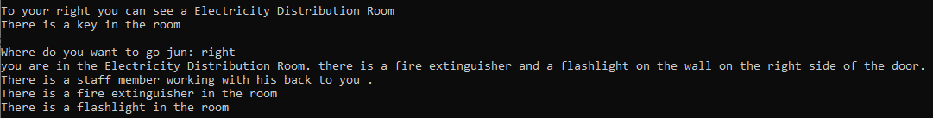
Electricity Distribution Room
This room is located on the right side of the office. It is a power distribution room. Players will pick up a fire extinguisher or a flashlight in this room. and an enemy

